Slide 1
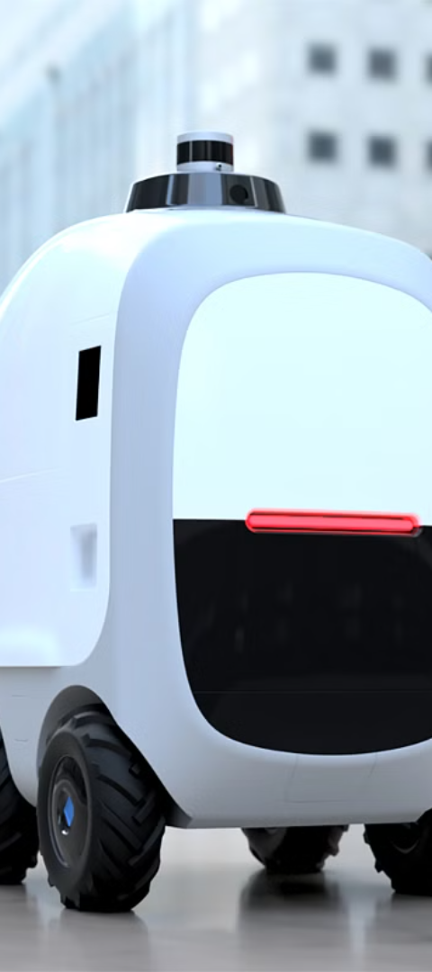
Autonomous mini vehicle delivery for food and e-commerce

Slide 2

TEAM MEMBERS:

Slide 3
MOTIVATION
The motivation behind implementing autonomous mini vehicle delivery for food and e-commerce lies in addressing the growing demand for efficient, cost-effective, and contactless delivery solutions. With the rise of online shopping and food delivery services, there's a need for a more streamlined and convenient delivery method that can navigate urban environments safely and autonomously, reducing delivery times and costs while enhancing customer satisfaction.

Slide 4
OBJECT AND SCOPE:
The objective of developing autonomous mini vehicle delivery for food and e-commerce is to revolutionize the last-mile delivery process by leveraging cutting-edge technology such as artificial intelligence, robotics, and autonomous navigation systems.
This initiative aims to achieve faster, more reliable, and environmentally friendly deliveries while minimizing human intervention and operational costs. Ultimately, the goal is to provide customers with a seamless and convenient delivery experience while optimizing logistics operations for businesses.

Slide 5
LITERATURE SURVEY:
Title of article | authors | Date of publication | Abstract
Autonomous last-mile delivery robots | Elin Alverhed, Simon Hellgren, Hanna Isaksson, | January 8, 2024 | self-driving autonomous delivery robots (ADRs) on last-mile deliveries. It explores how ADRs add value to the logistics and transport industry and contribute to competitive business models.
Last-mile delivery concepts | Hanna Palmqvist, and Jonas Flodén | March 6,2019 | examines various last-mile delivery concepts, including unmanned aerial vehicles (drones) and autonomous delivery robots.
“Toward a Modern Last-Mile Delivery | Lisa Olsson | July 18,2021 | This study explores last-mile delivery challenges, particularly in the context of e-commerce

Slide 6
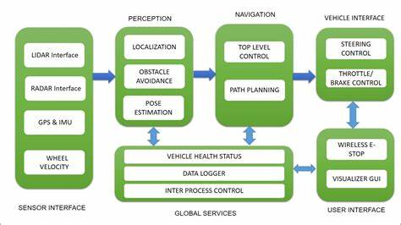
PROPOSED METHODOLOGY:

Slide 7
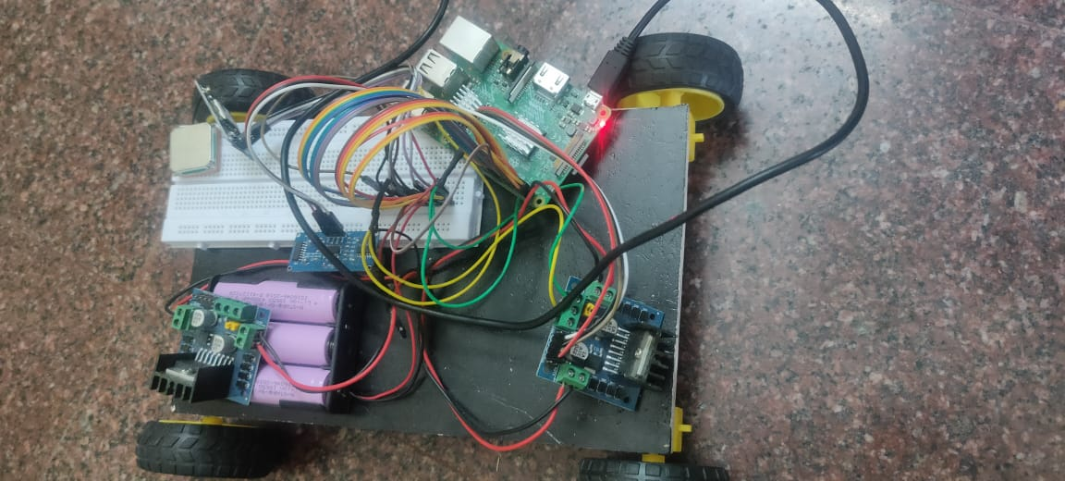
Image of the product

Slide 8
CONCLUSION:
Despite these challenges, the surveys point towards a future where autonomous mini vehicle delivery plays a central role in shaping the evolution of urban logistics. With continued research, innovation, and investment, autonomous delivery systems have the potential to unlock new opportunities for businesses, improve the quality of life for consumers, and contribute to a more sustainable and resilient supply chain ecosystem.
the journey towards autonomous mini vehicle delivery for food and e-commerce represents a transformative shift in the way goods are transported and delivered, offering a glimpse into a future where convenience, efficiency, and sustainability converge to redefine the last-mile delivery experience.

